Slide 1


The Précis
A précis is a clear concise, orderly summary of the contents of a piece of writing.

Slide 2

A précis is a passage:
that is boiled down so that only the essence of the original remains
that is a concentration of ideas from the original piece of writing
Ah, boiled down…sounds like the beginning of a good broth. I love soup.

Slide 3

How do you pronounce this strange word?
Pray-see.
I used to pray to see, until I got my glasses…now I can see everything just fine! Hah-hah, never let anyone tell you an owl can’t be funny.

Slide 4

Places where a précis could be used include:
speeches and conversations,
To shorten or summarize:
interviews,
books & magazine articles,
newspaper articles,
& lectures
legal papers and laws,
It might seem like an uphill battle right now, but the précis is a format that you will make great use of in your post secondary schooling
rules and regulations,
announcements,
directions,
business letters,

Slide 5

WHAT? You mean I have to write a précis? How do I do that?
Before you begin to summarize, you must first understand what is being said!
Step 1 Count the number of words in the original-your précis is ¼ the length of the original.
Understand first.Read the original piece carefully, and more than once!
You should annotate the article as you are reading it to understand the structure and how each paragraph contributes to the whole article.

Slide 6

Step 2: Sentence condensing
OK, so now I want a donut
Understand the central idea of each sentence. Cross out unneeded description.
Summarize each sentence of the article
Look at the example on the right.
“There is no icon in Canadian business more universally revered than Tim Hortons”.
Would become
Tim Hortons is a revered Canadian icon OR
Tim Hortons is an icon in Canada (even shorter)

Slide 7


Step 3: Use a dictionary!
Icon and revered. . . what the heck do those words mean?
Look up any words, or allusions that you don’t understand. In the previous example, if you didn’t know what the word “Icon” meant, you’d have missed out on much of the meaning of the sentence.

Slide 8

Still on step 3. . .
Include all articles (a,an,the) and prepositions (in,on out, of) that were in the original.
Pick out key words, think what their relation in thought is, and in this way find the central idea
Count contractions (don’t, can’t) as 2 words!
There is a fine balance between cutting out too much of the original, and getting down to ¼ the length of the original without losing the overall essence.

Slide 9

Step 4: Express your ideas concisely
Omit interjections i.e.) There was once a time, in the distant past, when I blah blah…becomes (click mouse)
i.e.) There was once a time when I blah blah…
Omit appositives i.e.) Jane Goodall, a remarkable woman, is someone who should become blah, blah, blah becomes
Jane Goodall is someone who should become…
Omit words that are used for emphasis i.e.) mediation becomes a constant inner unmasking, a peeling off of layer after layer of masks. Blah, blah,blah
mediation is a constant inner unmasking. Blah, blah,blah

Slide 10

Still on step 4:
Change similes and metaphors
i.e.) her thoughts in the morning are as tangled as her hair. Could become:
Her morning thoughts are incoherent.
Or he burst out of the door like an explosion, could become:
He burst out of the door.
Omit rhetorical questions by changing them to statements of fact.
So “aren’t there?”
Could become:
There are many ways to eat an ice cream cone.
Use hyphenated expressions where possible because they count only as one word. So a dog with one eye becomes a one-eyed-dog, and counts as 1 word!
.
You get more “bang for your buck” that way.

Slide 11
So to summarize:
Step 1 | Step 2 | Step 3 | Step 4
Count words in original | Cross out description | Get a dictionary | Omit interjections
Read original | Summarize sentences | -check for various meanings | Omit appositives
Re-read original | Summarize paragraphs | -check for spelling | Omit emphasis words
Annotate original | Check for overall idea of | “X” all articles | Change metaphor/ & similes
Understand sentences | -each sentence and | “X” all prepositions | Omit rhetorical Questions
Understand paragraph meanings | -each paragraph |  | Write your précis!

Slide 12
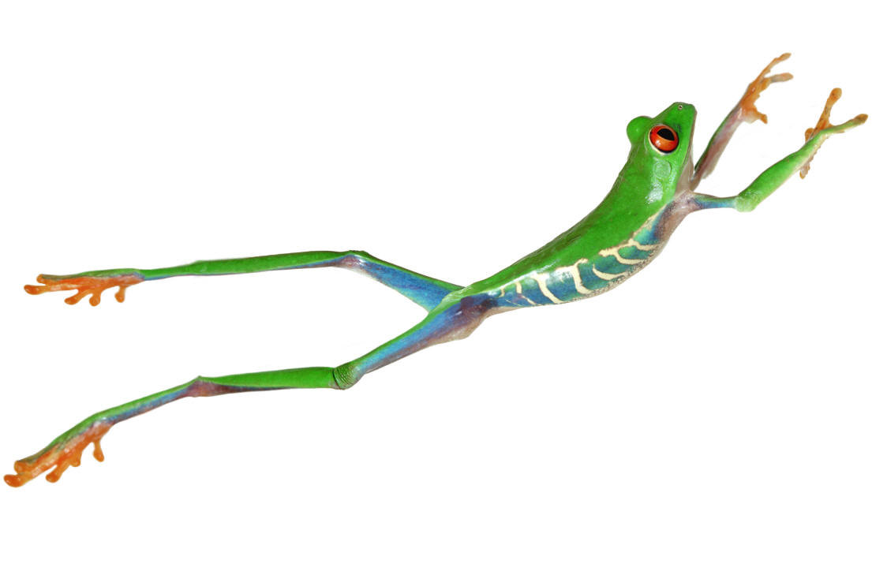
Now for a giant leap…
Let’s go through some examples…
and be more specific

Slide 13

Sentence 1
Your first sentence in the précis should have:
the name of author,
the genre & title of the work,
date in parentheses,
an active verb (such as "assert" "argue" "suggest" "imply" "claim“) and
a THAT clause which contains the thesis statement of the work.
This sentence is the who & the what of the original work.

Slide 14
Example for Sentence 1
Phillipa Gregory’s novel, The Other Boleyn Girl (2001), implies that ambition possesses the power to corrupt and dispense true gratification, filling the heart solely with desire infused with greed and the ravenous hunger to reign.
Notice the who and what is clearly defined in the first précis sentence.

Slide 15

Sentence 2: should contain:
an explanation of how the author develops and/or supports the thesis,
This is usually done in chronological order.

Slide 16

Example of Sentence 2
Gregory develops this assertion through vivid description of life in the Tudor court and examination of cut-throat antics of a ruthless family-members of whom will execute to attain absolute power.

Slide 17
Sentence 3 should be:
A statement of the author’s apparent purpose, followed by an "in order" phrase.

Slide 18

Example for Sentence 3
Gregory’s purpose of elaborating on ambition is to depict the outlandish lengths one will embark in order to fill a selfish void within one’s greedy and desperate soul.

Slide 19
Sentence 4
Sentence 4:
A description of the intended audience and/or the relationship the author establishes with the audience.

Slide 20
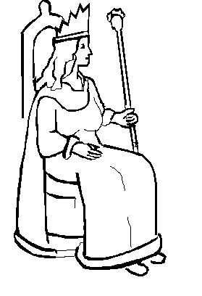
Example for Sentence 4
Gregory engages the average woman through the themes of scandal, conniving competition, and passionate lust, all of which evokes every woman’s desire to be a queen.

Slide 21
Now you are ready to start paraphrasing
Study each paragraph, read it to understand the main points then summarize the main points in your own words

Slide 22

Remember the following:
A précis retells the highlights so a reader will know main sections of the original
Writing a Précis
Précis is a clear, concise, orderly summary of the contents of a piece of writing.

Slide 23

A précis has only the essential details & they must be correct & accurate

Slide 24

A précis must be an original piece of writing that is ¼ length of the original
A four page article will become a one page précis
I must say, I am THE original…what a lovely specimen of a screen bean.
All words in the précis must be original…A few quotes are acceptable.

Slide 25
If you need further information:
Check out sources online @
http://lonestar.texas.net/~mseifert/precis1302.html
http://www.cranepsych.com/Psych/Precis.html
http://startup.curtin.edu.au/study/writing/precis.cfm

Slide 26



Hurray…now that we know how to write a précis, we are going to rush home and get them done.
Wait for us, Spot.

